Slide 2
learn fundamentals of Hbase,
explore concepts of ZooKeeper.

Slide 3

Introduction

Slide 4
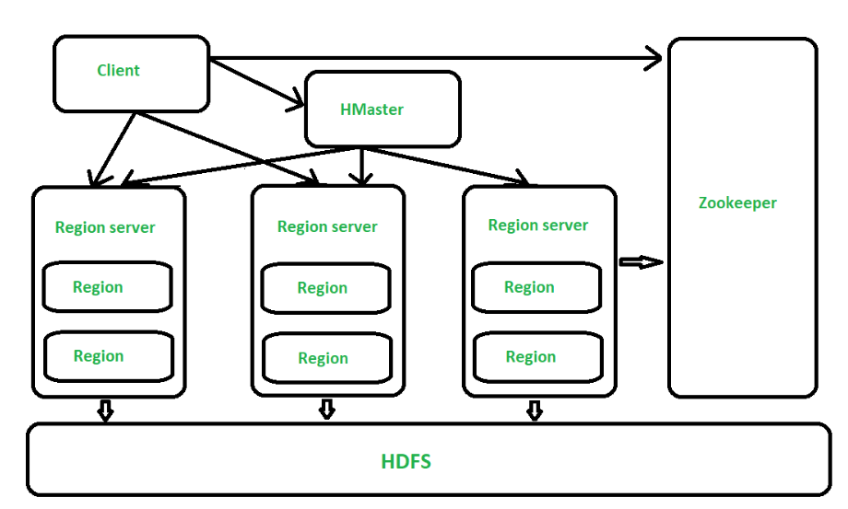
HBase - Architecture

Slide 5
Master Server
Assigns regions to the region servers.
Handles load balancing of the regions across region servers.
Maintains the state of the cluster
Is responsible for schema changes and other metadata operations

Slide 6
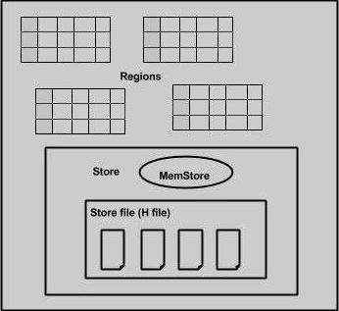
Regions

Slide 7
HBase Data Model
HBase Tables
HBase Row
RowKey
Columns
Column Family

Slide 8
HBase Data Model
HBase Tables
HBase Row
RowKey
RowKey
Columns
Columns
Column Family
Column Family

Slide 9
HBase Data Model
HBase Tables
HBase Row
RowKey
Columns
Column Family

Slide 10
HBase Data Model
HBase Tables
HBase Row
RowKey
Columns
Column Family

Slide 11
HBase Data Model
HBase Tables
HBase Row
RowKey
Columns
Column Family

Slide 12
Components of Apache HBase Architecture
Base architecture has 3 important components
HMaster
Region Server
ZooKeeper

Slide 13
Components of Apache HBase Architecture
Base architecture has 3 important components
HMaster
Region Server
ZooKeeper

Slide 14
Components of Apache HBase Architecture
Base architecture has 3 important components
HMaster
Region Server
ZooKeeper

Slide 15
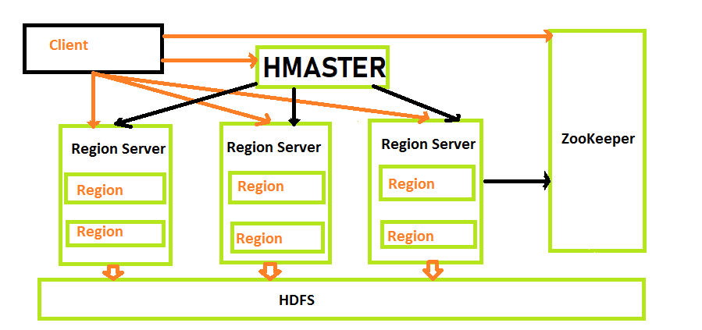
HMaster
Apache Hbase Architecture

Slide 16
Region Server
Region Server runs on HDFS DataNode and consists of the following components
Block Cache
MemStore
Write Ahead Log (WAL)
HFile

Slide 17
Region Server
Region Server runs on HDFS DataNode and consists of the following components
Block Cache
MemStore
Write Ahead Log (WAL)
HFile

Slide 18
Region Server
Region Server runs on HDFS DataNode and consists of the following components
Block Cache
MemStore
Write Ahead Log (WAL)
HFile

Slide 19
Region Server
Region Server runs on HDFS DataNode and consists of the following components
Block Cache
MemStore
Write Ahead Log (WAL)
HFile

Slide 20
Advantages of HBase
Can store large data sets
Database can be shared
Cost-effective from gigabytes to petabytes
High availability through failover and replication

Slide 21
Disadvantages of HBase –
No support SQL structure
No transaction support
Sorted only on key
Memory issues on the cluster

Slide 22
Comparison between HBase and HDFS

Slide 23
Comparison between HBase and HDFS:
latency access

Slide 24
Comparison between HBase and HDFS:
latency access
Random reads and writes

Slide 25
Comparison between HBase and HDFS:
latency access
Random reads and writes
shell commands

Slide 26

Introduction

Slide 27
Introduction
Zookeeper is an open-source project
Zookeeper has ephemeral nodes representing different region servers
the nodes are also used to track server failures or network partitions.
Clients communicate with region servers.
HBase itself will take care of zookeeper.

